Slide 1
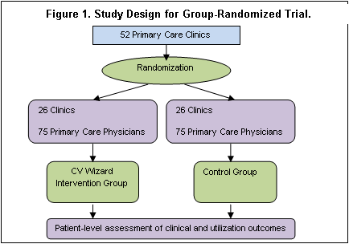
SMI Wizard : RCT to Reduce CV Risk
Cluster-randomized clinical trial that will include 50+ primary care clinics (150+ PCPs and 2250+ adults with SMI) at HealthPartners, Essentia & Park Nicollet, blocked within organization and randomly assigned 1:1 to SMI Wizard or control

Slide 2
SMI Wizard : Aims
Primary Aim: Determine whether adults with SMI receiving care in intervention clinics will have, compared to those receiving care in control clinics:
Hypothesis 1: Lower total modifiable CV risk
Hypothesis 2: Better control of specific modifiable risk factors:
BP, Lipids, Obesity, A1c, Smoking, Aspirin Use
Hypothesis 3: Lower rates of prescriptions for obesogenic SMI
medications at 12 months post-index
Secondary Aim: Explore impact on CV risk factor identification, treatment initiation/intensification, adherence, outpatient/inpatient utilization, risky prescribing events, CV events

Slide 3
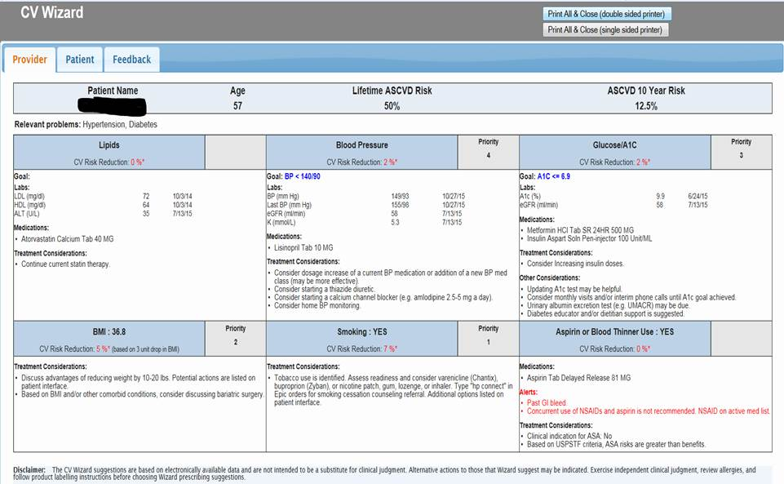
Provider Version

Slide 4
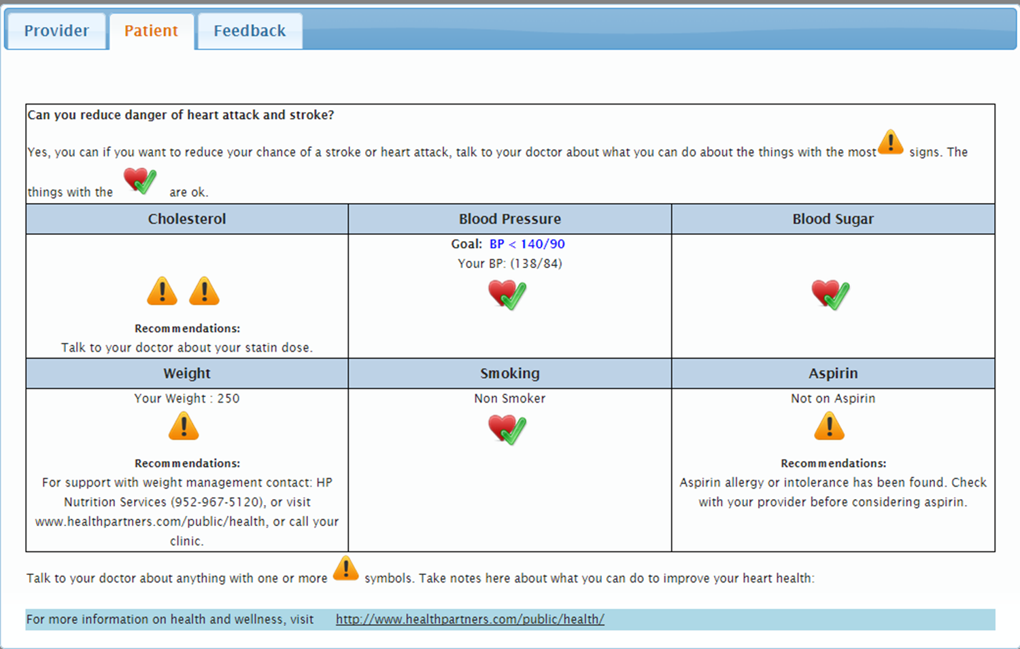
Patient Version

Slide 5
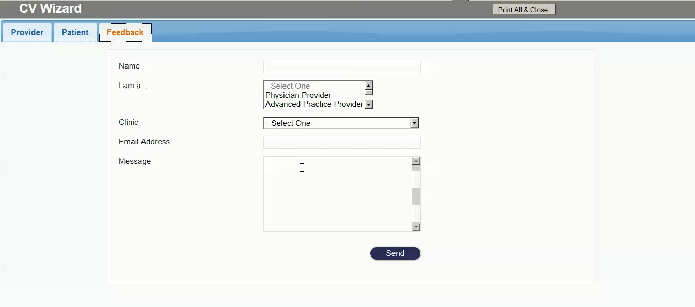
Feedback tab for providers

Slide 6
SMI Wizard : Key Timeline Dates
Jan 2016: Pilot at HPMG
Mar 2016: Implement at HPMG
Sept 2016: Pilot at Essentia
Oct 2016: Implement at Essentia
Dec 2016: Pilot at Park Nicollet
Feb 2017: Implement at Park Nicollet

Slide 7
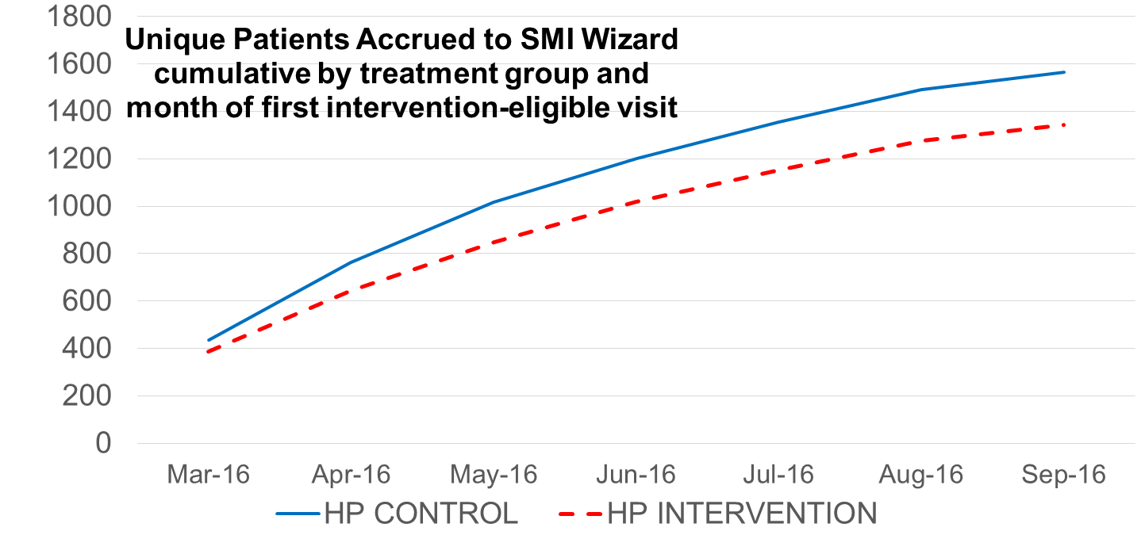
SMI Wizard : Patient Accrual

Slide 8
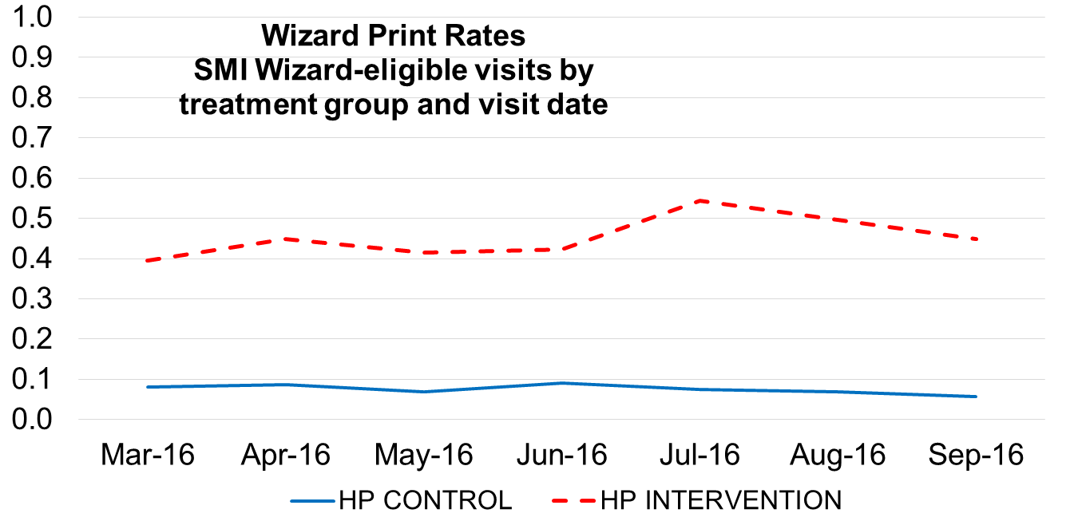
Fidelity: Print Rates

Slide 9
Patient Characteristics
 |  | Purple | Red | All
Male | % | 46.7 | 45.6 | 46.1
Age, years | M | 47.9 | 48.3 | 48.1
White | % | 74.1 | 79.1 | 76.8
Black, African-American | % | 18.8 | 14.2 | 16.3
Hispanic, Latino | % | 1.9 | 2.6 | 2.2
Asian | % | 2.9 | 1.3 | 2.1
Native American, Alaskan | % | 1.0 | 0.9 | 1.0
Hawaiian, Pacific Islander | % | 0.2 | 0.1 | 0.1
Other | % | 0.5 | 0.6 | 0.6
Bipolar | % | 69.0 | 75.6 | 72.6
Schizoaffective | % | 23.5 | 21.8 | 22.6
Schizophrenia | % | 22.7 | 16.9 | 19.6

Slide 10
Patient Characteristics
 |  | Purple | Red | All
10-yr CV Risk | M (SD) | 5.4 (6.6) | 5.1 (6.4) | 5.2 (6.5)
Reversible risk | M (SD) | 3.7 (6.5) | 3.3 (5.8) | 3.5 (6.1)
BP<140/90 | % | 73.1 | 79.8 | 76.7
Total Cholesterol | M (SD) | 179 (40) | 181 (46) | 180 (44)
BMI | M (SD) | 32 (8) | 33 (8) | 33 (8)
Current smoker | % | 46.2 | 43.1 | 44.6

Slide 11
Adverse Events
No differences in ER visits, hospitalizations or suicide attempts between groups
No provider reports of adverse events

Slide 12
SMI Wizard : Next up
Piloting at Park Nicollet Dec 2016
Implementation at Park Nicollet Feb 2017
Improving print rates and psychiatry engagement at HPMG

